Slide 1
ASSIGNMENT: FEATURES AND USES OF COMPUTER NETWORKS
Michael Munsambote
C001046
Level 2 extended certificate: Information Creative Technology
Notes:
All the images on this PowerPoint are from a website called computer hope – www.computerhope.com
The websites that I used to retrieve some of these information is also from the website computer hope - www.computerhope.com
1

Slide 2
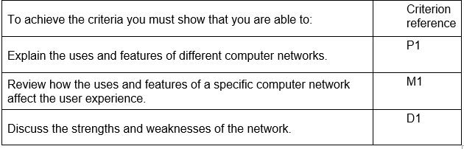
Assignment brief and Guidance:
You have been asked to help design and build a network and computing solution for your friend’s music shop, 'First Music'.
'First Music' does not have any computer equipment so your plan should include a complete network and computer system that meets these requirements and future expansion plans.
'First Music' will sell new and used music and allow customers to get ‘online’ in the store and download music. You are also planning to offer classes on how to download music and configure MP3 devices.
Factors to consider
the user experience, e.g. speed, connectivity, reliability
the reliability (frequency of network failure)
the performance (how quickly data is transferred across the network under different conditions).

Slide 3
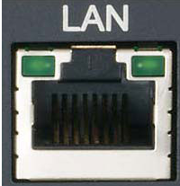
LAN (local area network)
A LAN (Local area network) is a network that is on a small geographical scale. You would find a lot of LAN’s in small offices, or group buildings. All LANs can connect to each other through telephone line making a WAN. You can connect LANs wirelessly and wired.
How this network will affect the users experience
LANs are known to be quite fast as they don’t have a lot of area to cover like WAN their speed range can vary from 90 Mbps to 600 Mbps, as it will be used in a music shops that will need to be using music software and apps, having a fast network will be important. This will help the company First Music because they would need fast connection when sending files. Connecting other workstations to your LAN network is really easy because you either connect wirelessly or wired and this means other users can bring their own devices in the music shop if they wanted to. LAN is more reliable than WAN because shared files aren’t being shared geographically meaning it will be quite hard for hackers to be able to have access to files. RAM would have network failure if you tried to get connection from a distance that is too far away. LAN can transfer data quite fast the Mbit’s for transferring data varies from 400 K/sec (24 MB/minute) to 100 MB/sec (6 GB/minute) which is quite fast and for a music company they will be constantly sending songs and files from one device to another.
Uses of LAN (local area network)
Home network (Wi-Fi)
Small offices
In a universities
IT shops or any shop
Advantages
You can share expensive peripherals like laser printers
A file server can be installed so you can store and share documents centrally.
You can electronically send emails between computers
All the computers on the network can be managed together
Disadvantages
Expensive to set up
Requires sophisticated servers
Violation of privacy
Maintenance job
Only covers small geographical area (within a city)
Notes:
Uses of LAN (local area network)
Home network is the most popular example of LAN because most homes have wired and wireless internet access.
In small offices have use LAN as they do not have a lot of ground to cover and they can share their network locally with other offices and they can store and retrieve files from their cloud.
I have chose to use LAN as the network that the music shop ‘First Music’ is going to use, I have chosen LAN because compares to WAN it is cheaper to set up. LAN also has a limited coverage which isn’t going to be too large for the music shop as there's only going to be one music shop created by this business, using LAN also means that I there can be a cloud that everyone in the business can access and in that cloud is where each person has access to store and file files and documents and use. Also it is easy to manage computers and for a music shop they would need to have the latest software and apps so when it comes to updating computers it can be done at the same time without any complication. However having choosing LAN network this means that the business would spent quite a lot of money as setting LAN network is not every cheap but affordable, and there’s a limitation to how big the company can expand to as there is a restriction is on the coverage as the network is based on a small geographical area (within a city).
3

Slide 4
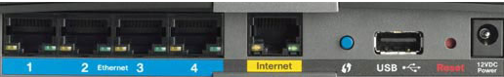
WAN (wide area network)
A WAN (Wide area network) is a computer network that is on a large geographical meaning going from one country to another country or even continents. Big companies like Apple and Samsung would use WANs because they are located all around the globe and they have offices everywhere. And using WAN would give all the offices the ability to communicate and share files. WAN is different LAN’s connected together.
How WAN will affect the users experience
WAN is very fast compared to LAN with the speed varying from 10 mbps – 1000 mbps (mbps is slow for a network). This would not be suitable for ‘First Music’ company because it is too slow. WAN network is less reliable compares to LAN because shared files aren’t being sent over a large area and hackers could interfere the transaction in the middle. WAN would experience network failure if your hubs aren’t powerful enough to connect to another. If network was to fail no one would be able to access certain files and you wouldn’t be able to use the internet. WAN transfers data really fast (100MB/sec – 155 Mb/sec) this is really fast because WANs have to cover a lot of ground. If the network was to fail then the users wouldn’t be a lot to use the internet, they also wouldn’t be able to share or store files that are stored in centrally.
The uses of WAN (wide area network)
Allows businesses on a large geographical scale to communicate
Advantages
Boosts privacy – your WAN can encrypt data
Cheap, increases profit – No need to travel for meetings
Disadvantages
High set up cost – even though LAN and WAN are expensive WAN is more expensive
security isn’t that good – Some hackers might be able to hack into the network
Maintenance issues – maintaining a network that operates 24/7 can be quite hard
Notes:
Advantage
Boosts privacy– WAN allows you to share data and for you to be able to do that you WAN has the ability to encrypt your data.
Cheap, increases profit – WAN s help increase profit because if there's need for a conference your workers wouldn’t have to travel out to different countries as you can have video conference and sending work will be easy as you are sharing the network
Disadvantages
Maintenance issues – maintaining a large geographical area like WAN can be hard work as there's a lot of workstations all connected to the same network , it can crash and because there’s thousands of people all connected at the same time it would have to be maintained 24/7.
Security – The security of WAN is at risk at all times as all parts of the business has to be secure because if one of them gets hacked by a hacker they would be able to influence the whole businesses system. It is quite hard to track down where the hacker started from as soon as they have access to the network.
4

Slide 5
Uses Of the Network
Networks may be used for different purposes as discussed below:
communication with other users: You can communicate by email, online chats, social media and forums.
Multi User Environment: Gaming – playing games online.
Sharing of Files: Sharing files is also important because you can store files centrally and this will make it easy to access. Storing files is centrally saved in the cloud, users will be able to save music and videos for business or individual use. Back ups will also be available for the users which means files won’t be lost and the network will be secure.
Sharing of Resources: you should be able to connect to a printer and print work or a scanner.
Home Chores: A good use of the network is browsing the internet it must be secure to allow the user to do online shopping and insert their card details into the website.
Collaboration: multiple people can work on the same file, they people can upload and retain work from the software. E.g. Trello, Wrike.
How does the network affect user experience
Speed – the network would have to be fast because users would be sending files across the network.
Security – The network would have to be secured because users wouldn’t want hackers to gain access to their files.
Connectivity (wired, wireless) – A network should have wireless connectivity because this would mean more people can connect to it and bring their devices to also connect to the internet.
Reliability – The network must be reliable otherwise users wouldn’t save their files or connected their devices to the network. Which is why the network has to frequently be backed up.
CAT6 – Having CAT6 wires means you network is backward compatible. This means you use files from and data that use the older version of the same program.

Slide 6
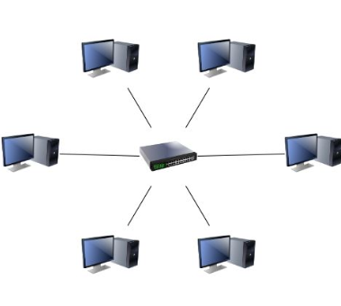
Which network I have chosen
I have chose to use LAN as the network that the music shop ‘First Music’ is going to use, I have chosen LAN because compares to WAN it is cheaper to set up. LAN also has a limited coverage which isn’t going to be too large for the music shop as there's only going to be one music shop created by this business, using LAN also means that I there can be a cloud that everyone in the business can access and in that cloud is where each person has access to store and file files and documents and use. Also it is easy to manage computers and for a music shop they would need to have the latest software and apps so when it comes to updating computers it can be done at the same time without any complication. However having choosing LAN network this means that the business would spent quite a lot of money as setting LAN network is not every cheap but affordable, and there’s a limitation to how big the company can expand to as there is a restriction is on the coverage as the network is based on a small geographical area (within a city).
Advantages
You can share expensive peripherals like laser printers
A file server can be installed so you can store and share documents centrally.
You can electronically send emails between computers
All the computers on the network can be managed together
Disadvantages
Expensive to set up
Requires sophisticated servers
Violation of privacy
Maintenance job
Only covers small geographical area (within a city)
Notes:
6

Slide 7
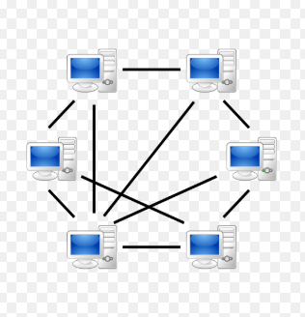
Peer to Peer Architecture
In a peer to peer network all the work stations are connected to each other either wired or wirelessly. Meaning files can share be instantly shared between devices without the need for a central server like a hub or switch.
How peer to peer will affect the users experience
Peer to peer servers are quite slow as everyone is using the network at the same time without any restrictions. The user would have to set restrictions that the other users would have to follow other wise they would be able to access their files. The speed of peer to peer depends on how many workstations are connected (if there's a lot the server will tend to be quite slow and if there's not a lot the server will be quite fast). Connecting new workstations to the server is really easy you can connect each device wirelessly or you can connect using wires. Peer to peer server is less reliable compared to client server as if one workstation gets a virus, it could spread to every other workstation as it each users responsibility to make sure that they're workstations backed up and secure. Data transfer within a peer to peer server is easy as you are able to access another users workstation to retrieve files, this can be a risk as users might get access to files that are private.
Advantages
There’s no need to buy an expensive server as each workstation has access to all files
Less expensive compared to client server
There's no need for specialist staff (e.g. network technician) as each user sets their own restrictions
Setting up is easier
If a workstation fails it wont affect the network or any other workstation
Disadvantages
Files aren’t centrally backed up meaning if files are lost they are gone there's no way of getting them back
Security is not good as each user has to make sure their workstation is backed up and secure
Workstations can become slow
Making sure that there's no viruses is a responsibility for each user
There's not a lot of security except the restrictions.
Notes:
The information on this page I got it from a website called www.teach-ict.com/gcse_new/networks/peer_peer/miniweb/pg5.htm
7

Slide 8
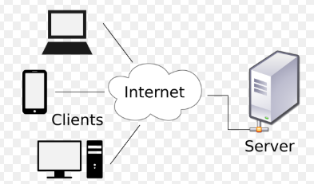
Client Server Architecture
In client server network all the workstations are connected to the server and the server sets all the restrictions such as what files you can access, what website you can go old, etc. All files are centrally stored in the server so everything is backed up. The server can be upgraded so it works faster.
How client server will affect the user’s experiance
Client server – server is quite fast if you have a high end hub, within client server – server if your hub is high end then your workstations will be high functioning. Connecting new devices to your hub is easy as it is done wired (with one wire going from you workstation to your hub). Client server – server is more secure compared to peer to peer because as long as your hub is backed up and secured frequently all your workstations connected will also be backed up and secure. This server is not as reliable as your hub can crash, if you hub crashes your workstations wouldn’t be able to access the internet or share files. Transferring files through client server – server is easy as files are shared to you through the server and files are centrally backed up in hub.
Uses of client server network
Used in schools
Used in universities
Small business
Advantages
All files are centrally stored
Network restrictions are controlled centrally
Backups and security are controlled centrally
Users can only access shared data
More secured compared to peer to peer
Disadvantage
You will need a network specialist
Servers can be expensive
If the server fails then the whole buildings workstations that are connected to the server will not work
Notes:
Text book
http://www.teach-ict.com/gcse_new/networks/peer_peer/miniweb/pg3.htm
8

Slide 9
Which network architecture is have chose
After viewing the information for client server and peer to peer I have came to the conclusion that the best network architecture to use is client server as it means users have set restrictions to which files they can access and which they cant, also all files are backed up in the hub. All workstations are made secure in the hub. Connecting new devices to star topology can be done wirelessly meaning client will be able to bring their devices to the shop and connect onto the network
Advantages
All files are centrally stored
Network restrictions are controlled centrally
Backups and security are controlled centrally
Users can only access shared data
More secured compared to peer to peer
Disadvantage
You will need a network specialist
Servers can be expensive
If the server fails then the whole buildings workstations that are connected to the server will not work

Slide 10
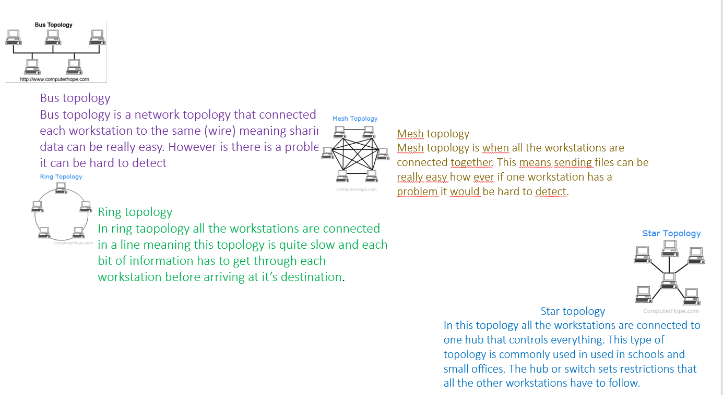
Task 1: The features and uses of computer networks
Network topologies
Network topology shows the layout of a network. It shows you how each workstation and or hub is connected to each other. Network topology describe how workstations share files and how they transfer data.
Uses Of Network Topologies
Schools
Offices
Big companies (apple)
Advantages
It has low expenses
Easy to set up and connect workstations
Its good for small networks
Disadvantages
Its not easy to find fails in within the network
Cable length is limited
Not very fast working

Slide 11
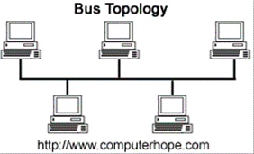
Bus Topology
Bus topology is a network topology that connected each workstation to the same (wire) meaning sharing data can be really easy. However is there is a problem it can be hard to detect.
How bus topology will affect the users experience
BUS topology is not fast because every computer on the network has to transmit through one cable. it is either computers are waiting for one another or there is collision on the network which means slow network. When it comes connectivity it can be hard for bus topology as you connect by using a wire, and the wires are quite expensive and to repair is also expensive. Bus topology isn’t very reliable as you constantly have to make sure that your workstations are running as otherwise your network will crash. However transferring files through bus topology is quite hard as it has to got through every workstation between the two workstation.
Uses of bus topology
Small offices
Advantages
Installing a Bus topology is easy
Cheap instillation
Doesn’t require much cable
Disadvantages
If a main component fails the whole network would go down
Becomes slow because of data collision
Security is a risk and everyone on the network has access to all files
Notes:
https://www.bbc.com/bitesize/guides/z36nb9q/revision/4
11

Slide 12
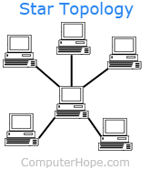
Star Topology
In this topology all the workstations are connected to one hub that controls everything, in the hub is where all files are backed up and made sure is secured as if someone hacks into your hub they would have access to all workstations connected. This type of topology is commonly used in used in schools and small offices. The hub or switch sets restrictions that all the other workstations have to follow.
How star topology will affect the users experience
Star topology is a fast topology if your hub is high end, and as the owners of ‘First Music’ are willing to spend quite a lot when it comes to security, their network if going to be fast. Connecting a new device to star topology is quite easy as you can connect wirelessly which means other client would be able to bring their own devices and connect to the hub and share files. Star topology is reliable because if your hub is backed up and has anti-virus then all your workstations connected will be secure, all files are connect file’s are backed up on the hub. Star topologies are not common to network failures as long as your hub is good. Sending files through star topology is really easy as because files are shared through your hub and only goes through your hub and device which your sending to which makes star topology more secure compared to the other topologies.
Uses of Star topology
Small offices
Schools
Small businesses
Advantages
Very reliable – if a wire breaks the network wouldn’t go down
High performance – there is no data collision
Disadvantage
Expensive to install
Extra hardware is needed (hub switch,)
You need specialist to maintain you network
If the hub fails the workstations would have access to the internet
Notes:
As they're willing to spend a lot this the best to use.
12

Slide 13
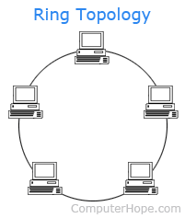
Ring Topology
In ring topology all the workstations are connected by one wire. Transmitting data can be quite slow as data only travels in one way and if there’s a lot of workstations before your location, sending data will be really hard. Workstations are connected by using wires.
How ring topology will affect the users experience
Ring topology is a good topology however there isn’t a hub or switch setting restrictions meaning users will be able to do anything. Data transmission is quite slow as it has to go through every workstation in the way, this also results in low security has no files are kept secret. Connecting new devices to the network is easy and it doesn’t affect the network. When it comes to reliability ring topology isn’t very reliable as each workstation has to be managed as if one workstation fails then the whole network would go down. Sending files through ring topology is quite slow as if there a lot of workstations in between the 2 workstations between the two sending the files it would have to go through all the workstation in between.
Uses of Ring topology
Small offices
Advantages
Data travels in one direction preventing data collision
Hub is not needed
Data transfer is fast
Connecting other workstations to the network is easy and it doesn’t affect the performance
Disadvantages
Data transmission speed if slow
The whole network will go down if one workstation fails
Hardware is expensive

Slide 14
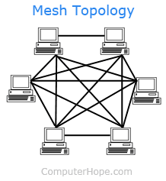
Mesh Topology
Mesh topology is when all the workstations are connected to each other, in this topology data transmission is really easy as multiply devices are connected. However problems are hard to detect. Data can still be transmitted if one connection is cut.
How Mesh Topology will affect the users experience
Mesh topology will be good for the company to use. Data transmission is fast and multiple workstation can send data at a time. Mesh topology is also fast as each device is independent and doesn't affect the network. Connecting new devices to Mesh topology is easy and it doesn’t affect the network. Mesh topology is very reliable because if one device fails it doesn't affect the network. Sending files through Mesh topology is easy as each workstation is connected to each other and if the way they’re connected fails there's other ways that the data could reach its destination.
Uses of Mesh Topology
Large companies (Asos)
Advantages
High amounts of data transmission doesn’t affect the network
If a workstation fails it would fail the network
Adding more devices doesn’t affect the topology
Disadvantages
Setting up costs a lot
There’s a need for a network specialist
Replacing broken wires costs a lot

Slide 15
Which network topology I have chosen
The topology that I have picked for the company ‘First Music’ is Star topology as it a high end topology and it isn’t too expensive. Making sure files and workstations are backed up and secure is all done centrally in the hub which lowers the risk of network failure and workstations getting hacked. Sharing files is also done in the hub. This network also allows users to download music as they have internet access which is controlled and permitted to each user in the hub. Also adding new devices to you network is easy meaning customers can bring their devices. Also if you hub is secure then all you workstations will be secure
Advantages
Very reliable – if a wire breaks the network wouldn’t go down
High performance – there is no data collision
Disadvantage
Expensive to install
Extra hardware is needed (hub switch,)
You need specialist to maintain you network
If the hub fails the workstations would have access to the internet

